Slide 1


Slide 2
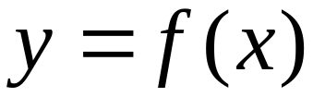
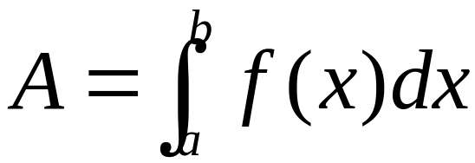




Slide 3
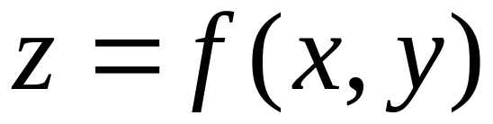
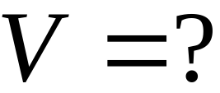


Volume of a solid

Slide 4
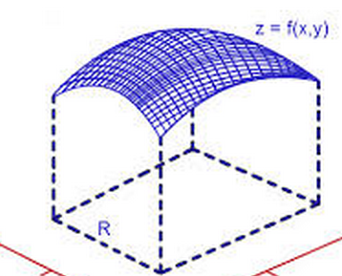

Slide 5
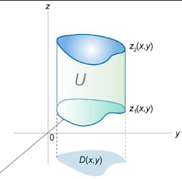


Slide 6






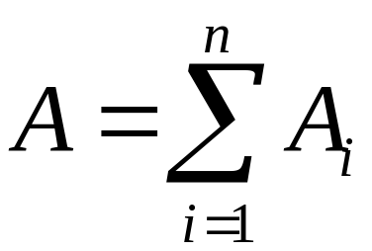
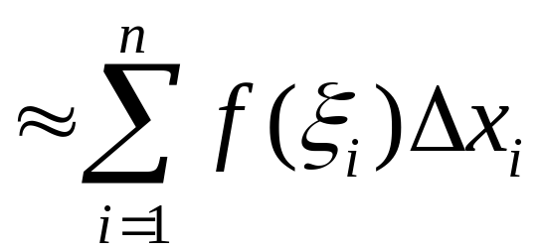
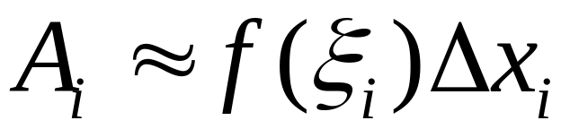
Recall

Slide 7

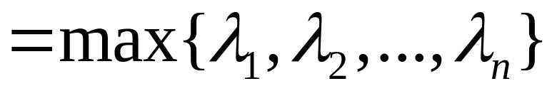
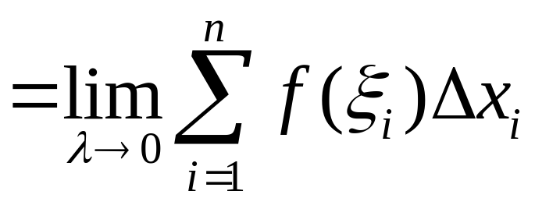
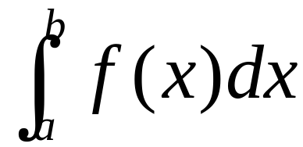


Slide 8
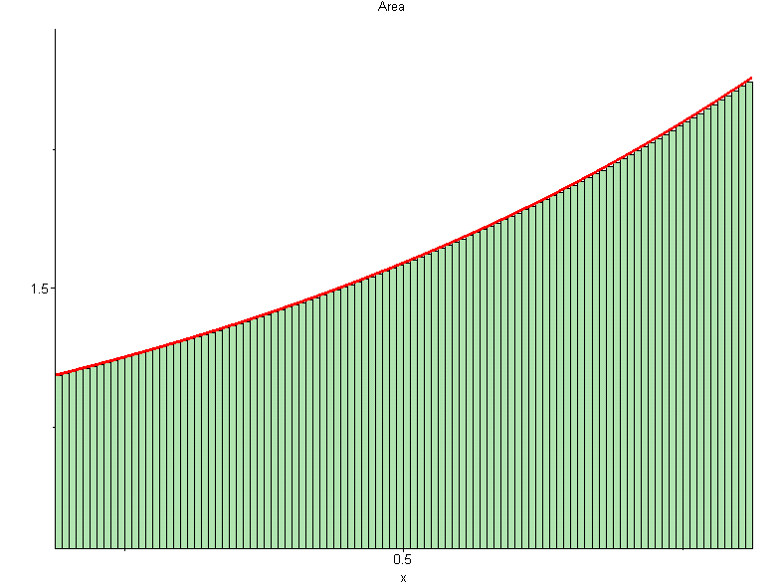
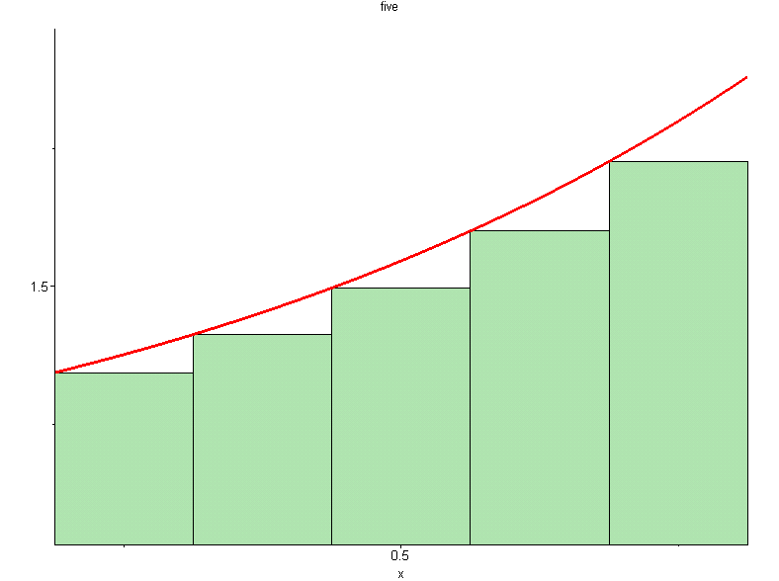
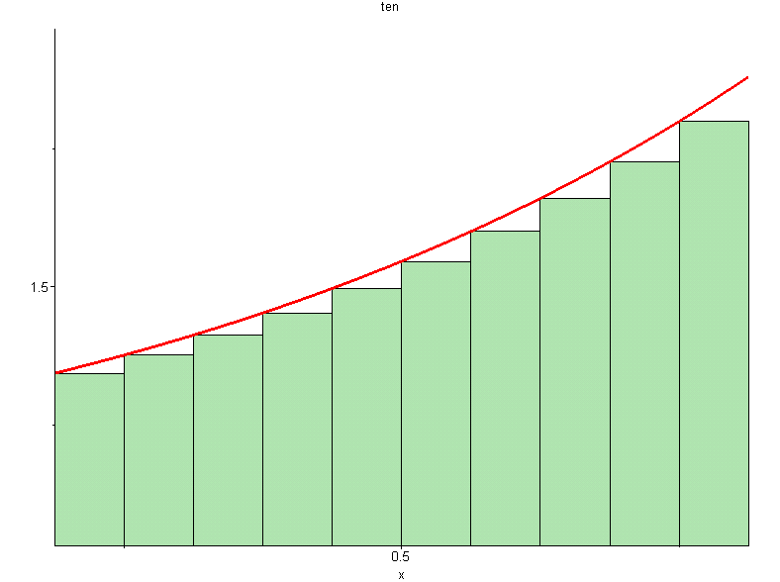
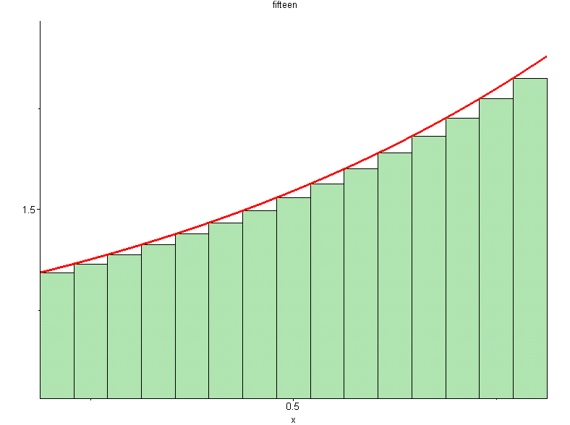

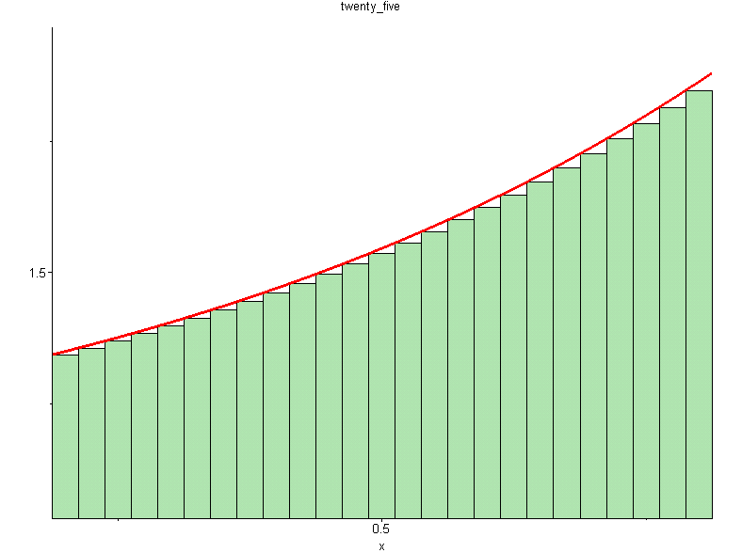
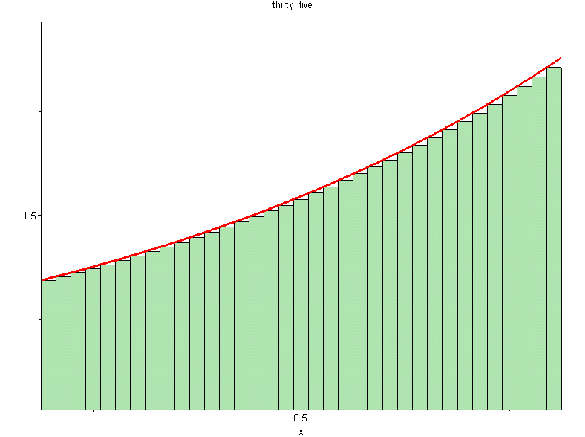
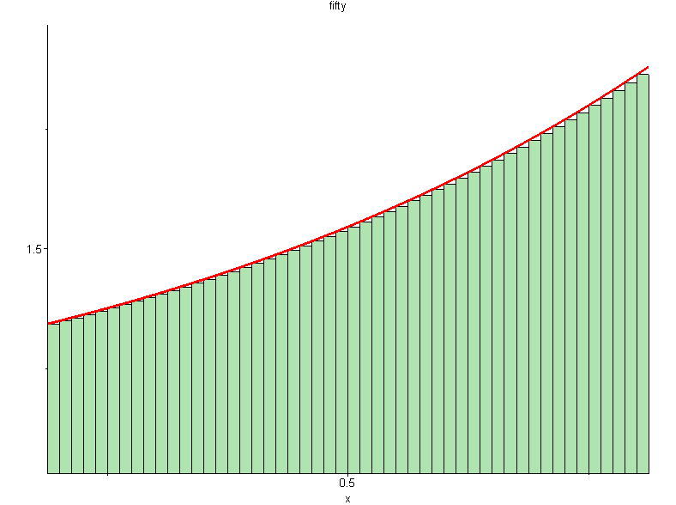



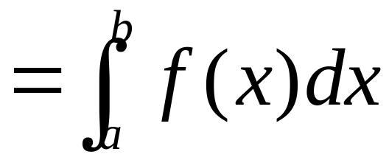

approximation
Area = ?
Please click to see the changes

Slide 9
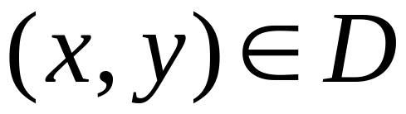
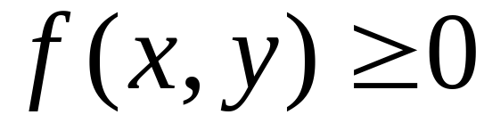

Volume
Volume: V

Slide 10


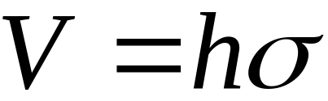
Special case
Circular cylinder =base
X height

Slide 11
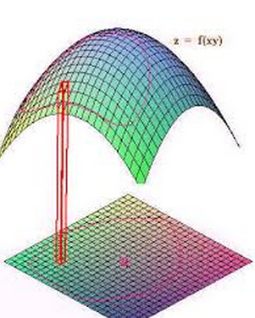
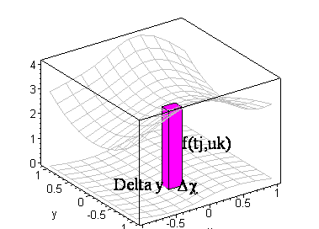

Slide 12
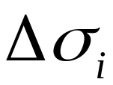

Subdividing the region: D：

Slide 13
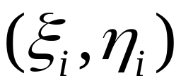
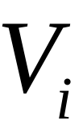
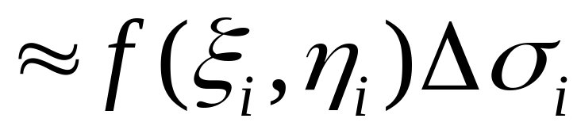
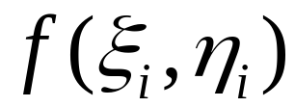
Sample points

Slide 14
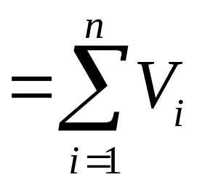
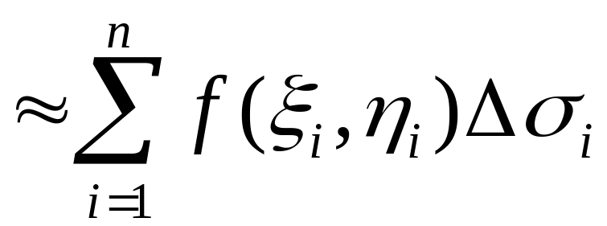

Slide 15

将D分割成 (1) 趋近无穷多块？
(2) 面积趋近为0?
(3) 直径趋近于0?
Diameter:

Slide 16


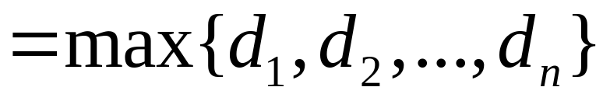
diameter

Slide 17
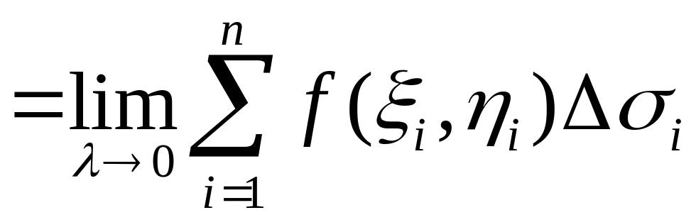


Slide 18

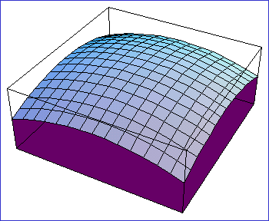
an animation
播放

Slide 20
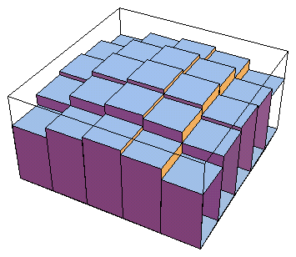

Slide 21
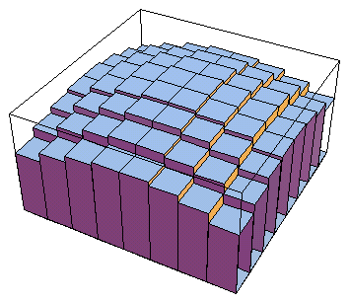

Slide 22
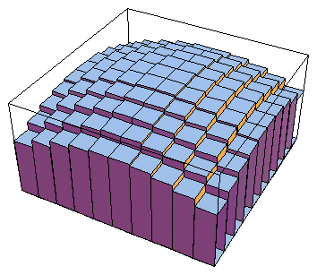

Slide 23
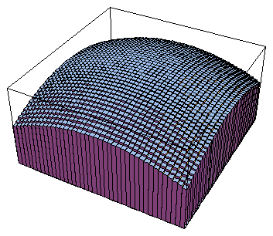

Slide 24
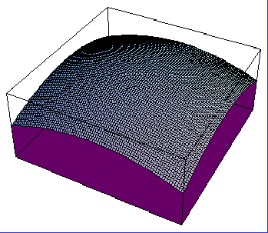

Slide 25
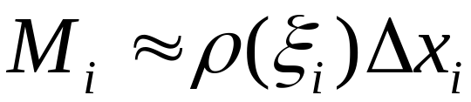
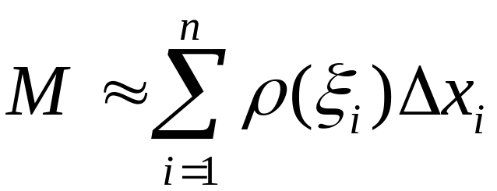
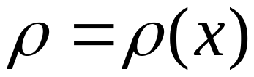
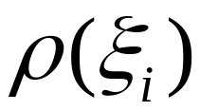
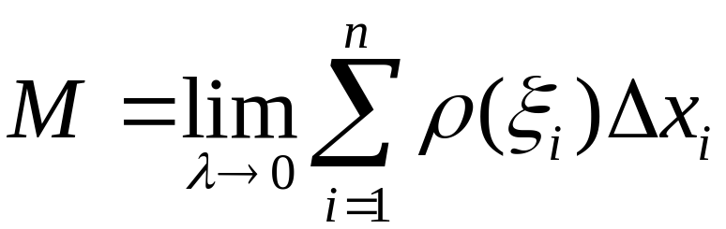
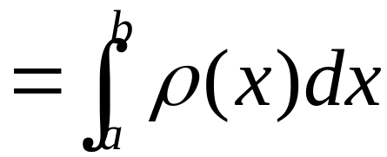
Mass of a lamina
Recall
Density function：

Slide 26
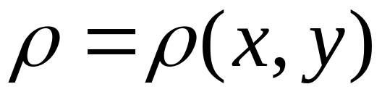
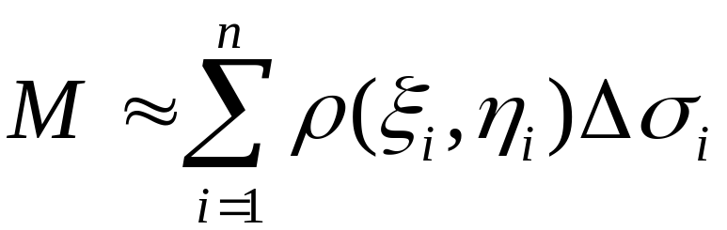
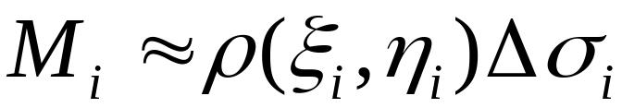
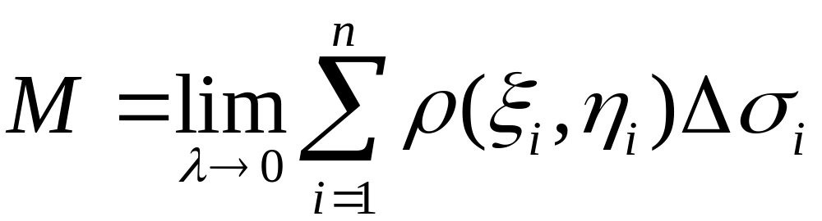
Density function：
subdivision
choose

Slide 27
Compare
The ideas and the math behind are the same

Slide 28


Definition
is bounded on D
D：bounded closed field
Independent of the way of subdivision and the choice of the sample points
domain
integrand
Area element

Slide 29



Model for volume
Top surface of the solid
Mass of the lamina
Density function

Slide 30
Integratable?
Continuous or piece wise continuous functions on a bounded closed field is integratable

Slide 31






Area element in rectangular coordinate system
Area element

Slide 32

Double integral in rectangular form

Slide 33




Example
Find
Solution
Top surface

Slide 34


The integral is the volume of the top half sphere
= V
V

Slide 35


Slide 36




1
Pf.

Slide 37








2
Linearity

Slide 38








3
（additivity)
D₁ and D₂ no common interior points

Slide 39










4
= area of D
5

Slide 40




Example
Find
Solution
= D’s area

Slide 41





6
so

Slide 42



性质 7
（估值定理）
证:

Slide 43








Estimate
since

Slide 44









Slide 45



8
（mean value theorem）
If f(x, y) is continuous on D，
then there is a point
s. t.

Slide 46


Example: If f(x,y) is continuous with f(0,0)=2, find

Slide 47
End

